Slide 1

Predicting High‑Impact AI & Climate Papers
Early prediction of whether AI + climate/sustainability papers (2020–2024) will become highly cited using OpenAlex metadata and PySpark-based ML.

Slide 2
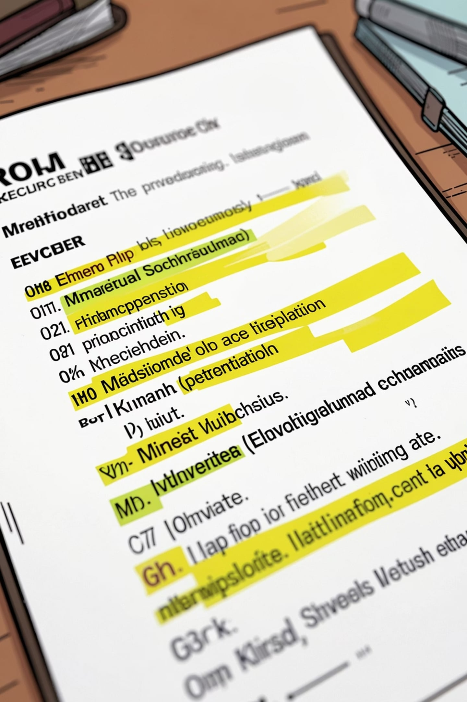
Research Question
Primary
Subquestions
Can early OpenAlex metadata predict top‑10% cited AI + climate papers?
Which features matter most? Role of open access, collaboration, topic, venue, early citations? Best ML model?

Slide 3
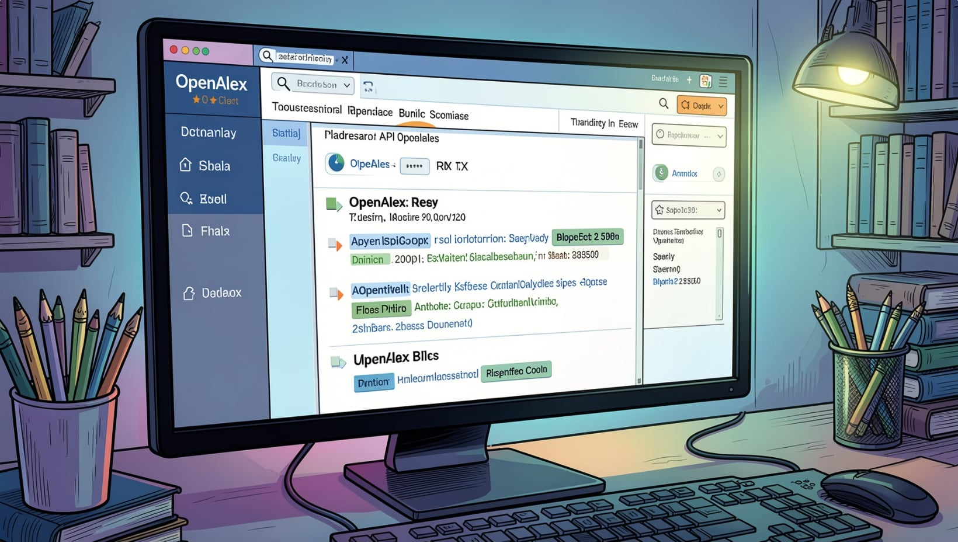
Dataset Source & Scope
Key details
Source: OpenAlex API. Scope: AI + climate/sustainability papers, 2020–2024. Data: research paper metadata used to build labels and features.

Slide 4






Main Features Extracted
Title
Publication year
Paper title
Year of publication
Author & Institution counts
Open access
Author count, institution count, country count (international collaboration)
Whether paper is freely available
Topic / Venue
Citations
AI, climate, energy keywords and journal/conference source
Early citation counts; total citations used to create label

Slide 5
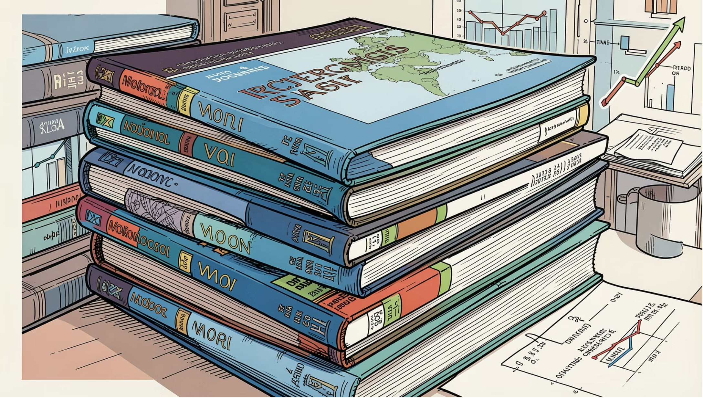
Labeling: High‑Impact vs Not
Label: Top 10% cited papers → "High‑impact". Remaining 90% → "Not high‑impact". Total citations (post‑window) determine thresholds.

Slide 6
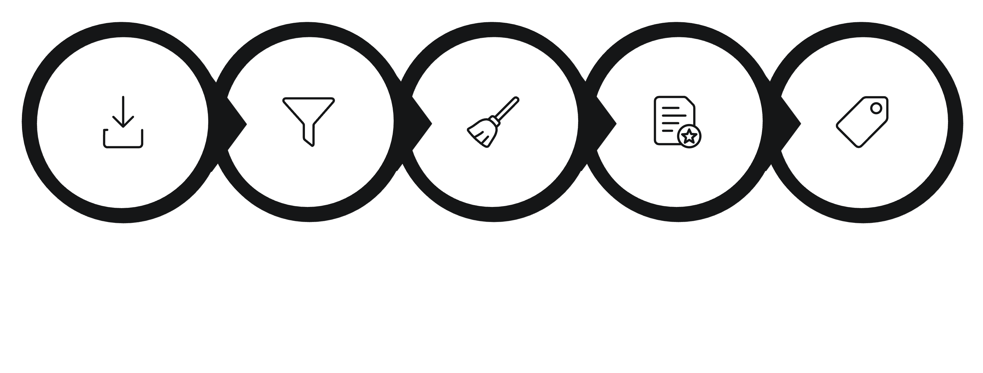
End‑to‑End Pipeline (PySpark)
Collect
Filter
Clean
Feature
Label
PySpark handles scalable cleaning, joins, feature engineering, and model training for large OpenAlex metadata sets.

Slide 7

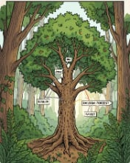
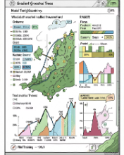
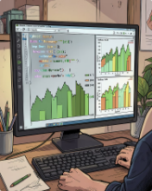
Models Evaluated
Logistic Regression
Random Forest
Gradient‑Boosted Trees
XGBoost / LightGBM
Baseline interpretable classifier.
Ensemble for nonlinearity and feature importance.
High accuracy for structured metadata.
Optional fast, scalable boosting libraries.

Slide 8
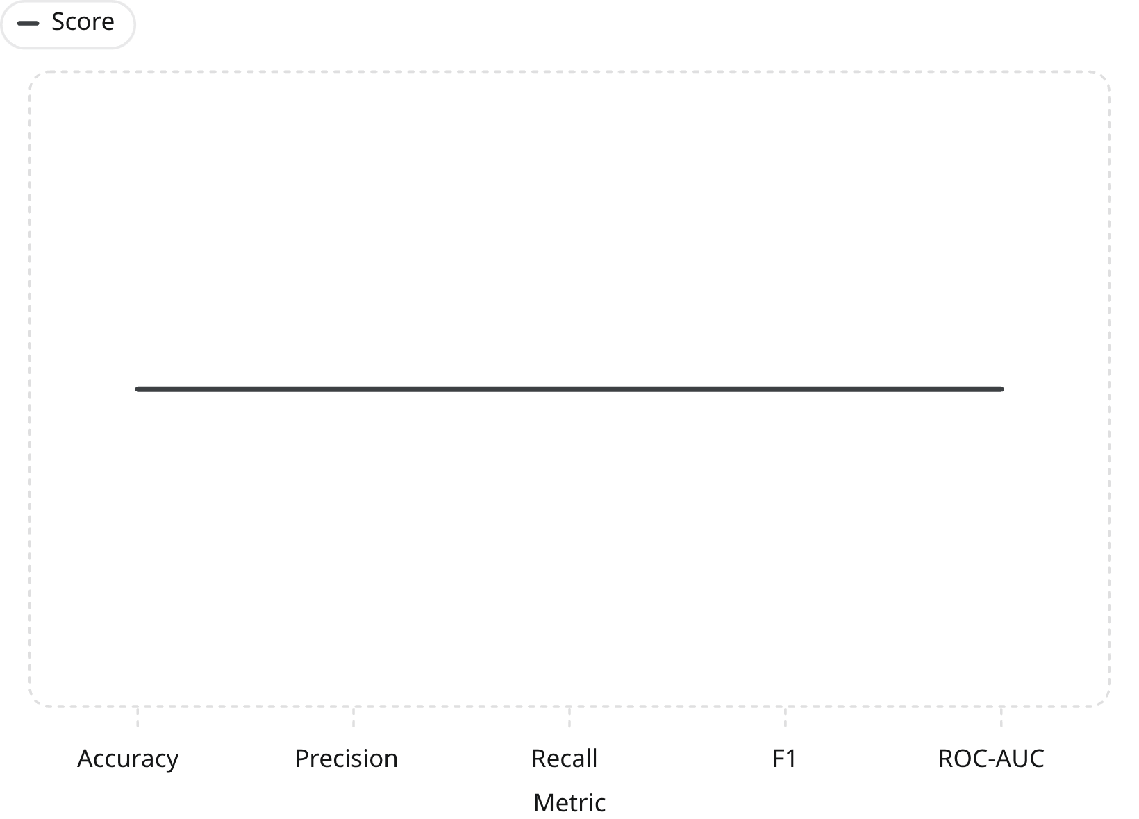

Evaluation & Metrics
Compare models using Accuracy, Precision, Recall, F1‑score, and ROC‑AUC. (Placeholder chart shown; populate with experiment results.)
Report per‑model metrics and choose model balancing recall for high‑impact detection and precision for precision of predictions.

Slide 9
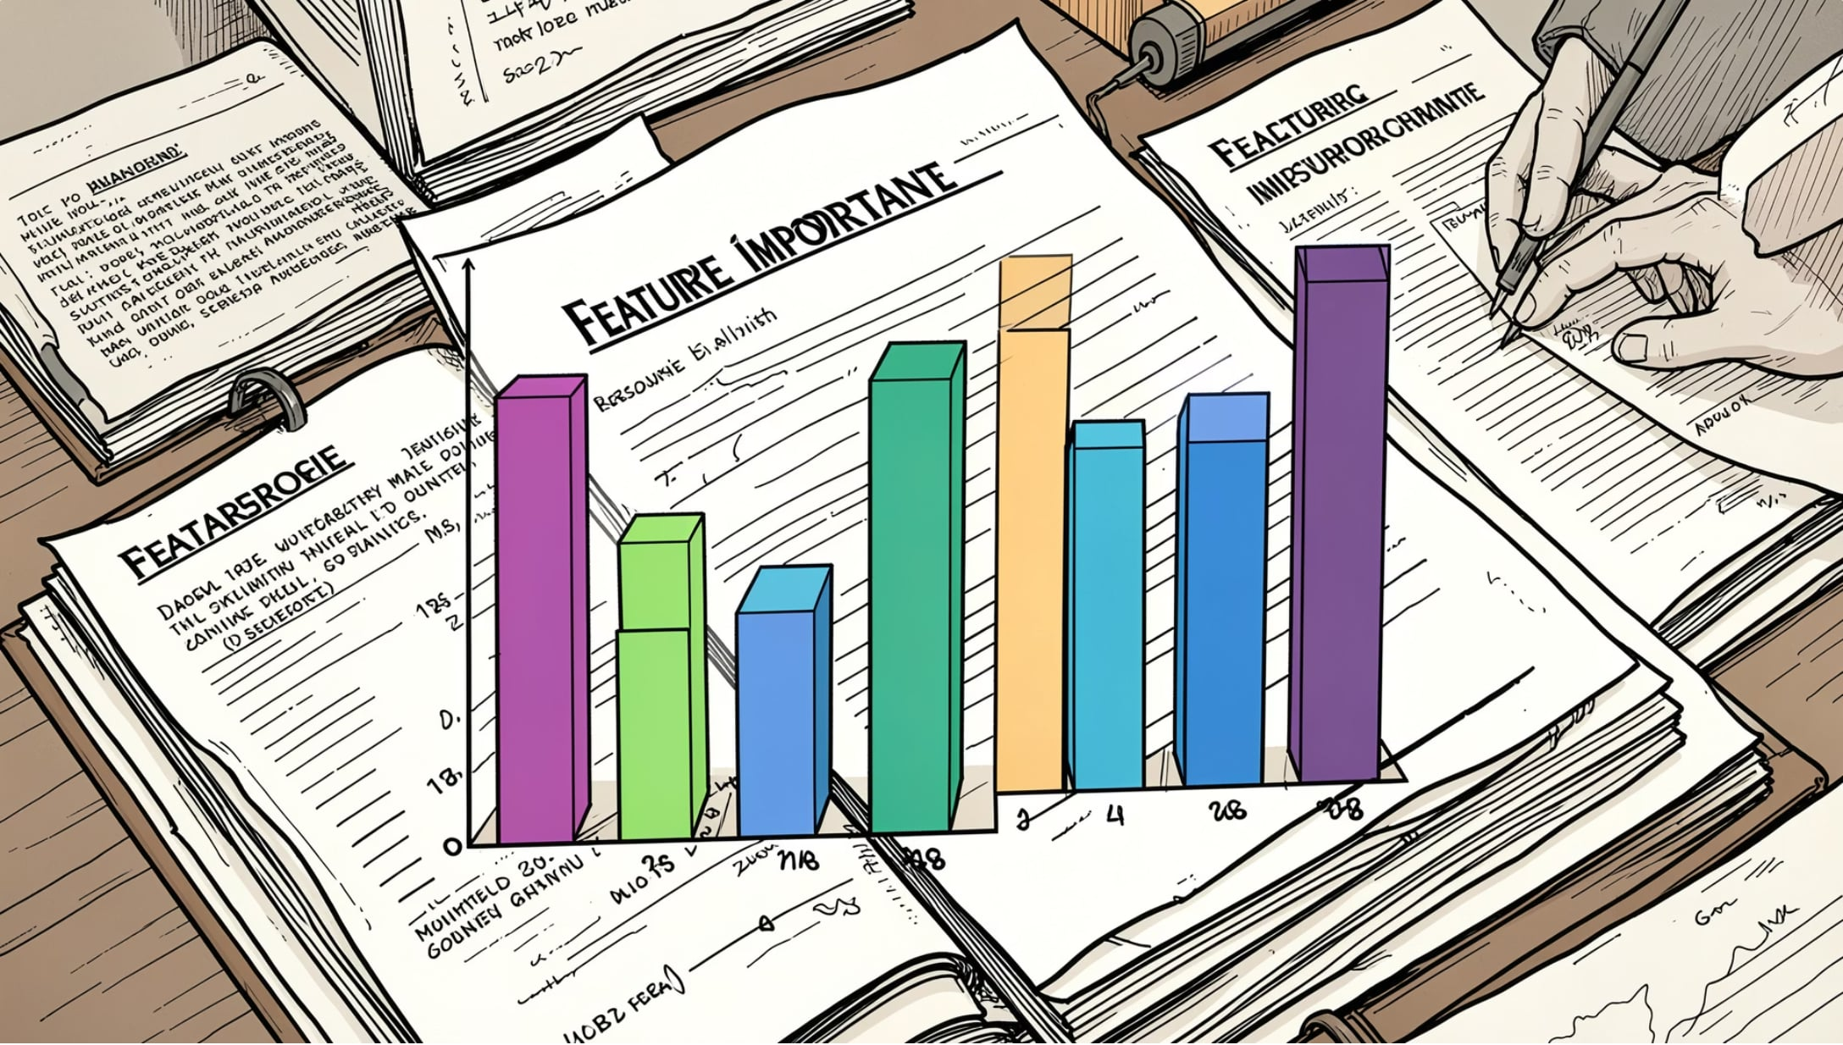
Feature Importance & Insights
Early citation count — strong predictive signal
International collaboration (country counts) — increases visibility
Author & institution counts — mixed effects
Open access — potential boost in citations
Topic and venue — disciplinary and venue prestige matter
Use model explainability (feature importance, SHAP) to quantify effects and guide interpretation.

Slide 10

Outcome & Next Steps
Deliverables
Research Output
Clean OpenAlex dataset, PySpark pipeline, trained models, evaluation results, feature‑importance analysis.
Publishable paper demonstrating early citation prediction for AI + climate scholarship.
Next Steps
Refine features (text embeddings, altmetrics), calibrate thresholds, deploy model for early discovery and recommendations.

